Slide 1
15 Laws of UX That Every Designer Should Know

Slide 2
15 laws of UI/UX
UX is a vast field, which people always align to “solely creativity” but there are some fixed principles.
These principles are based on user behavior, expectation, and research carried over the years.
The phrase “user experience” refers to all the interactions that people have with a product, including visual design, information architecture, usability, interaction design, and user research.
There is a set of widely accepted psychology laws, or standards, which are frequently used by UX designers to guide their design decisions.

Slide 3
15 laws of UI/UX – 1. Tesler’s Law
Also called as “The law of conservation of Complex states”. This law states that there is a certain amount of complexity that would be intrinsic to that system, and that complexity can’t be lessened or zeroed but can be managed. As a UX Designer, your responsibility is to possibly make the complexity feel reduced and managed, to help users focus on a goal.
For example: To add a task or reminder a single tap on the calendar should be enough. Adding any text or heading “Add task” would make it feel cluttered.

Slide 4
15 laws of UI/UX -- 2. Postel’s Law
Also named as “Robustness Principle”. This law talks about What you should accept and What you ask from your users. “Limit what you ask and be flexible to accept, creates a robust system”. Don’t unnecessarily bother users with pop-ups and questions which aren’t needed, better ask what is actually needed and help users to take action easily.
For example: The Netflix login page, they have a very simple ask – Enter your email to get started. This is the optimal way to ask for the necessary information.

Slide 5
15 laws of UI/UX -- 3. Aesthetic – Usability Effect
This principle says that users perceive aesthetically pleasing user interfaces as more usable. A great example of this is “dribble inspirations”. Being a designer you must hear people saying that “Go and check inspirations on dribble”. This is because on dribble there are a lot of good “UI themes and design ideas” which can be used as an inspiration, but not to rely on the experience. Most of the dribble designs are just pleasing but not usable. These designs mask the usability issues, which are found during usability testing.
Therefore there would be a clear separator line between the user interface and the overall experience of a product, app, or website.

Slide 6
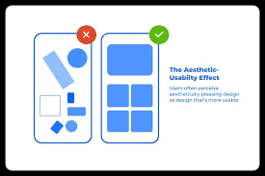
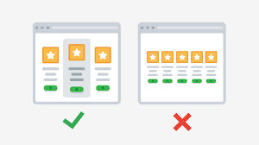

Slide 7
15 laws of UI/UX – 4. Target-based action(Fitts Laws)
This principle implies “The size of the target and time to reach would be directly proportional to making action”. Basically, fitts law is the check for “ease of target reachability”. The lesser time and bigger the target would make the action more obvious and clear. Not just meaning by random placement and even sizing of the target(button), matters
So follow standardized size and distance between the context and action point.
For example: Product details and action to buy now/add to cart or secondary action to add the product to the wishlist should be placed in such a way that it’s clear and prominent enough for the user to take an action.

Slide 8
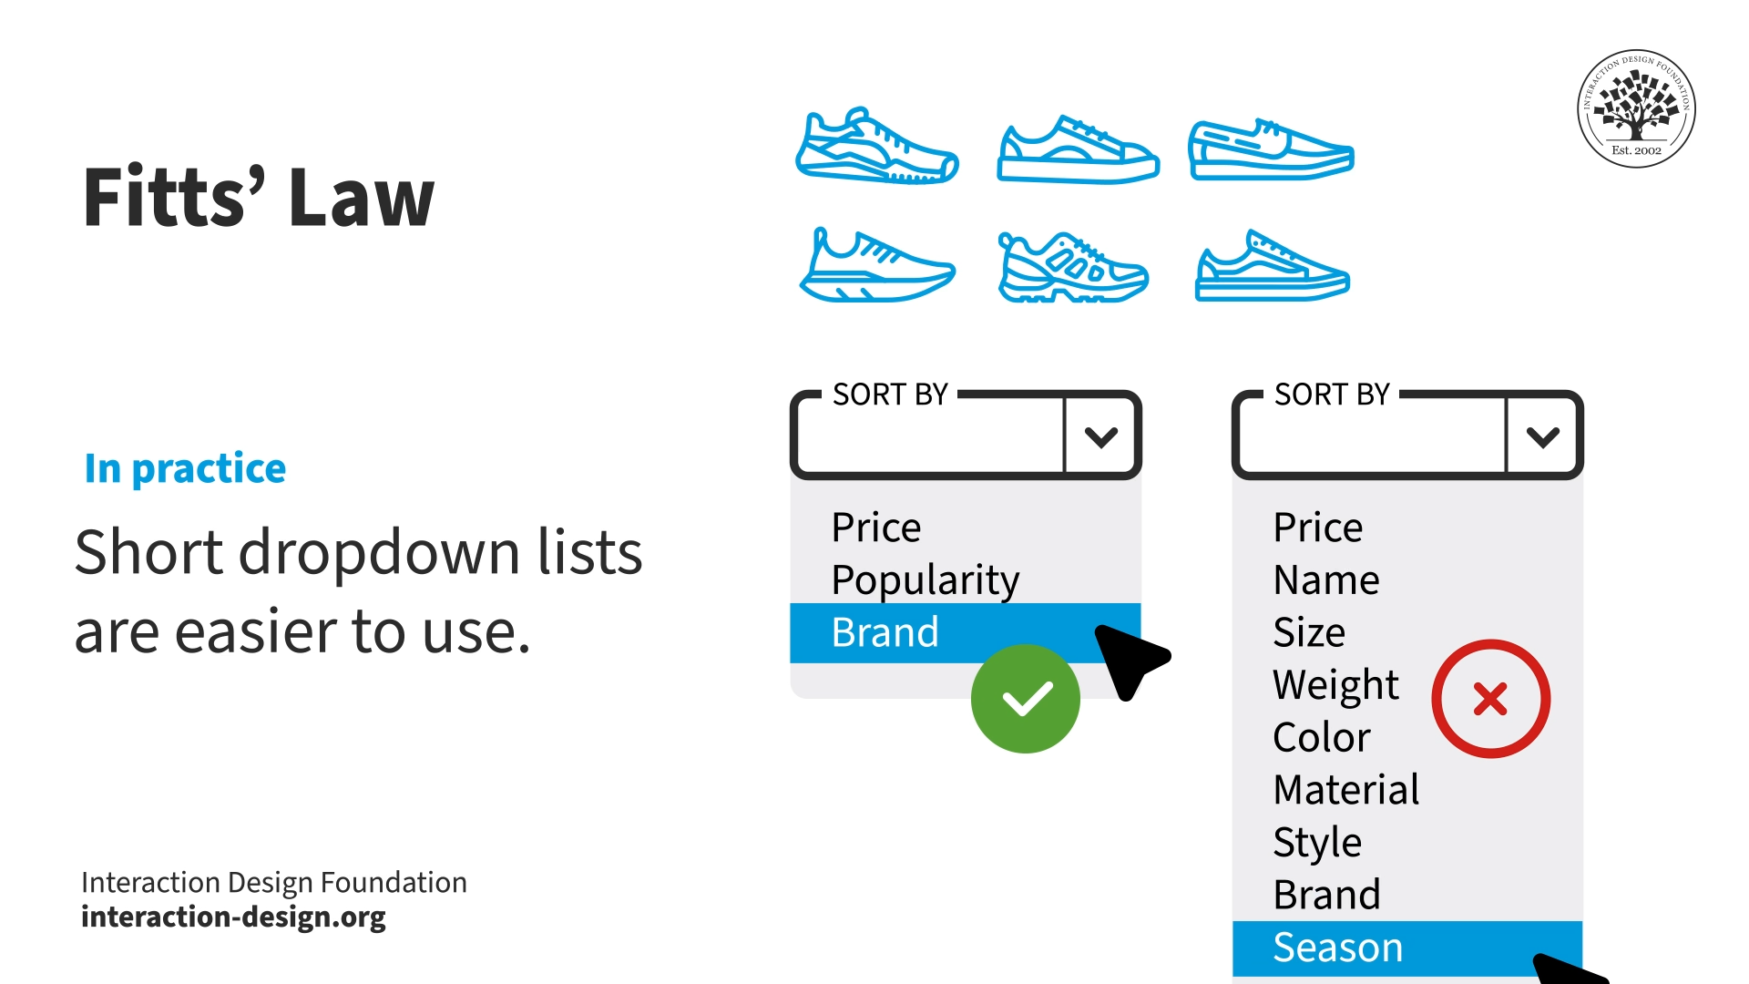

Slide 9
15 laws of UI/UX -- 5. Laws of optimal choice capacity(Miller’s Laws)
This principle is very important and popular among designers when working on complex problems where the choices for a user can be many or even infinite sometimes.
This law says that the “Human brain functions in a certain way that they can optimally capture and make a choice out of 7(plus minus 2) number of items. But look now this study has been updated and now the optimal capacity for humans to keep items in working memory is reduced to only 3 to 5 things.
Implementing this law and creating interfaces that support humans to recognize rather than recall is very much needed. Due to mobile phones, do you even remember phone numbers now? No right similarly going into the next 50 years the research might be even shocking. To support human memory, decide information into small chunks.
For example: The use of wizards for complex forms with progress bars at the top.

Slide 10
15 laws of UI/UX -- 6. Time based performance (Parkinson’s Law)
It says that “Any task will grow till the time allotted is used up.” This law explains the value of time for a business as well as for the users. Major takeaways from this law would be:
Keep the task completion time to the amount of time consumers anticipate they will need.
Use functionality like autofill to help and ease complex form filling during onboarding and payment forms.
Chunk bigger actionable items into small actionable items, which tend to be finished.

Slide 11
15 laws of UI/UX -- 7. Similar Reference(Jacob’s Law)
Jacob’s law states that “users like to have a sense of similarity in websites, as they spend time on other websites.” To explain this better, suppose if you’re planning to build an e-commerce brand, there would be a lot of different touchpoints with which the user interacts. To attract users and give the expected e-commerce experience to your user, try to understand What, Why, and How.
For example: Amazon, Flipkart, and even any other e-commerce website you look at, there are similar patterns which they use. Such as the Product display page includes – Images of a product, details about it, reviews and ratings, and CTA to add to the bag or to the wishlist. These elements are fixed, but to make a difference there are visuals, color, and brand identity which makes Amazon and Flipkart into unique e-commerce websites.

Slide 12
15 laws of UI/UX -- 8. Peak End Rule
This rule says that “People judge the experience based on how they felt at the peak moments of their user journey through an app”. Peak moments can be onboarding, crucial payment, and check-out experience. Rather than summing up the overall experience, peak moments signify how they felt about the product/app. A major takeaway here would be to focus on each stage of the user journey. Think through how at each stage you can make the experience enjoyable.
For example: Add catchy illustrations for onboarding, to explain what is going on and how they can get over it.

Slide 13
15 laws of UI/UX – 9. Occam’s Razor
This rule says that “Pick a design with the least possible complications”. These complications in a design could be an added cognitive load. The basic idea is to give the easiest and simplest design to the user by removing elements until it is compromising any design’s primary function.

Slide 14
15 laws of UI/UX -- 10. Doherty Threshold
According to Doherty’s threshold, the ideal interaction pace between humans and computers should be no more than 400ms. This talks about “design response time”. 0 to 400 ms is the ideal time to hold the user’s attention. If the response of any action isn’t shown within 400ms, there is a high risk of losing users. It is also an acceptable use-case that sometimes loading time can be more than 400ms, but as a designer ensure the design engages users in the meantime. Major takeaways from this law are:
Engage user attention within 0 to 400 milliseconds, to encourage action and navigation.
Use the progress bar to show the current state, telling the user that work is going on in the background.
Animations can be useful to catch user attention.

Slide 15
15 laws of UI/UX -- 11. Pareto Principle
It is also called the “80-20 Rule”, which says that “80% of the outcomes are from the 20% of work”.
This could be very useful for the time when there is a shortage of resources, and time in a project. As a designer decide and ideate the elements which are most useful and would create a bigger impact if designed and added to the experience.
Design majorly works on the ROI(Return on investment), here 80% of the returns can be through 20% of the investment.

Slide 16
15 laws of UI/UX -- 12. Zeigarnik Effect
“Interrupted or incomplete tasks are remembered over the complete ones”. Here one of the major factors could be the recency effect (when a person remembers the last thing) and another thing could be human psychology. It is the stickiness of that particular leftover task to memory that keeps on pushing the user to complete it. For example: Whenever solving a jigsaw puzzle, when just one piece is missing that makes the whole picture look incomplete.
For example: If a user has added products to the card, when the next time the app opens, remind them of checkout. Major takeaways from this law can be:
Provide visual cues of progress and the outcome of it to motivate users to complete the task.
Make sure content discovery happens through clear signifiers.
Take me to the place where they left, the next time when they open the app(might not be done every time, there could be a threshold) or better provide an indication of what is left to be completed.

Slide 17
15 laws of UI/UX -- 13. Von Restorff Effect
Also called “The Isolation Effect”, says that “People tend to remember unique or slightly different elements on the screen as compared to similar objects”.
This is because unique elements among a lot of similar elements capture attention fast.
So a major takeaway could be – Place the information you want the user to look at in a visually distinct manner. This could be bundling information as a video in a page full of text or using any distinct color to aid attention.

Slide 18


Slide 19
15 laws of UI/UX -- 14. Serial Position Effect
“People tend to remember first and last items in a sequence of elements.” This effect is a great approach to take forward when designing navigation. Keep in mind what could be the first and last option to place to help users easily navigate and the other elements can be placed in the middle. Designing in such a way improves memorization.
For example: Such as Instagram navbar, has a home and profile section on the right and left. Indicating 2 major interactions a user would likely make.
https://webdesign.tutsplus.com/how-to-use-the-serial-position-effect-to-design-better-websites--cms-93034a

Slide 20
15 laws of UI/UX -- 15. Hick’s Law
This law states that “Too many choices exhaust the user’s ability to make decisions quickly”. When there are an unlimited number of choices for a user to make, they would take more time to come to a final decision. This behavior is called “Analysis Paralysis”, where a user due to a lot of choices is not able to make a decision. The major takeaway from this law is to limit choices for users, to expedite the decision.
For example: Whenever you want to purchase ice cream at an ice cream parlor, due to a lot of options under each, you tend to take more time than usual to make a decision as compared to a shop where you have only a few options to pick from.

Slide 21
15 laws of UI/UX
The list entails the best theorems and principles that one should know and observe closely to become a good UX Designer.
However, the list is not limited to the above principles, In fact, there are lots of other principles too that you should know and learn as and when required.
https://medium.com/@FlowMapp/20-laws-of-ux-design-that-each-of-us-faces-every-day-part-1-48f9bd2a4fd2
https://qualaroo.com/blog/rules-for-ux-beginners/
Very informative ..

